Slide 1
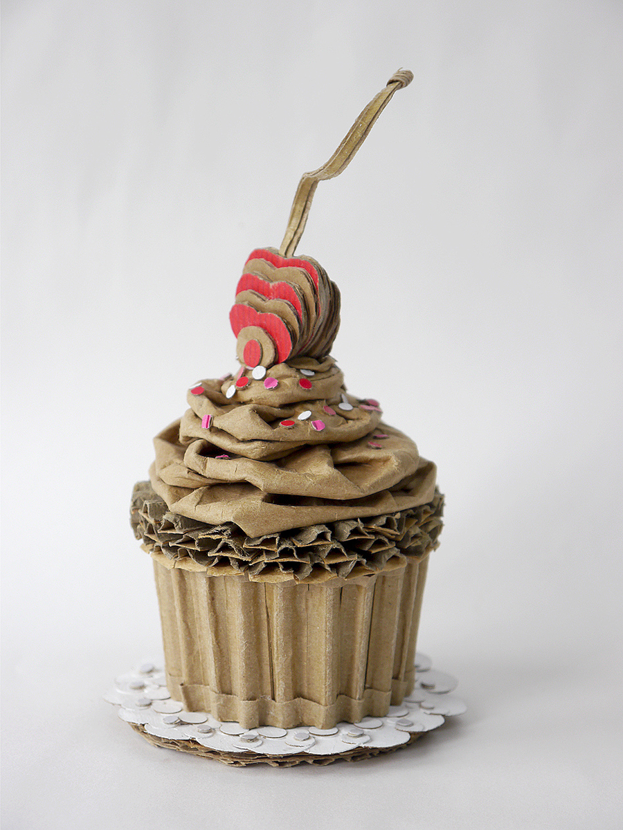
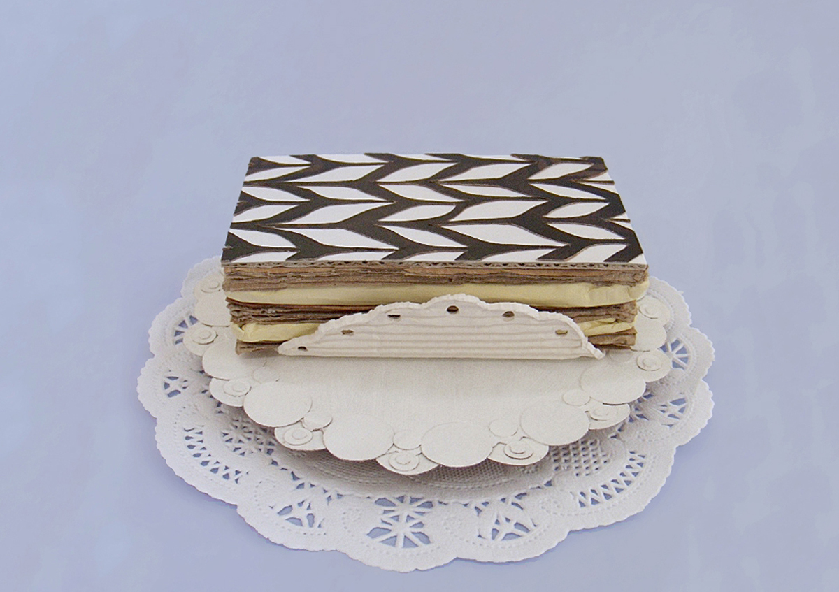
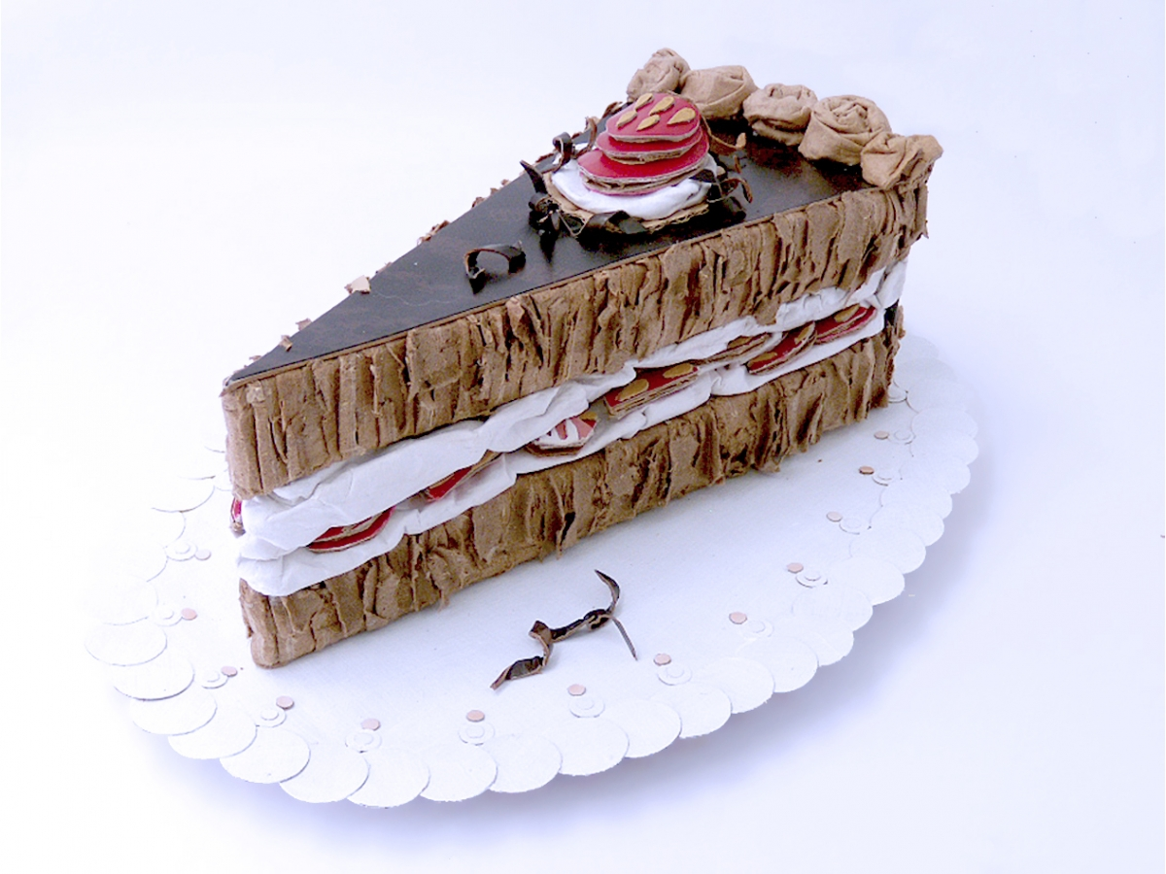
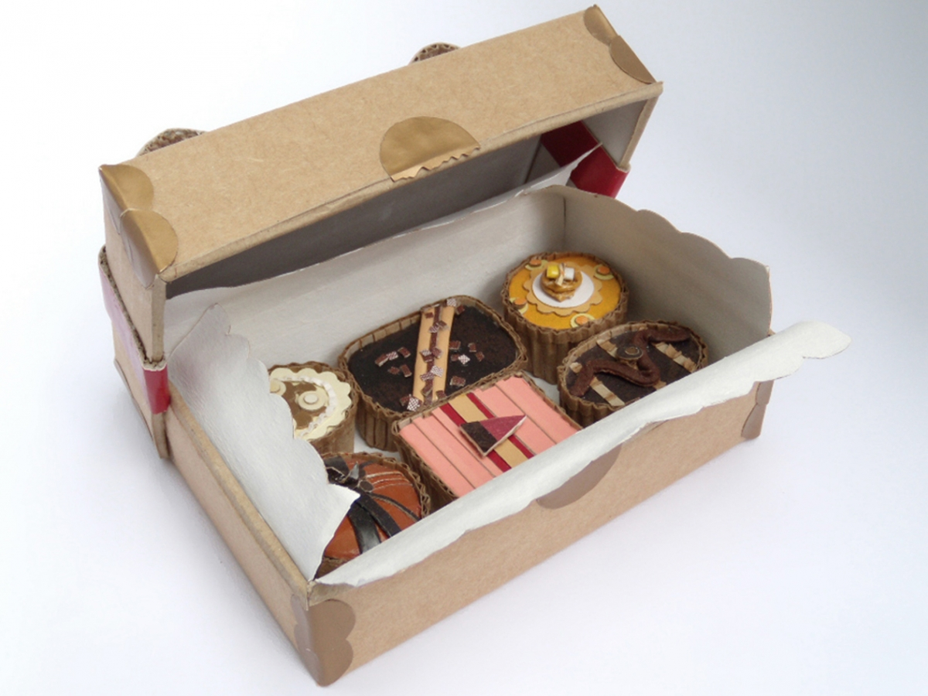
Sweet Treats

Slide 2
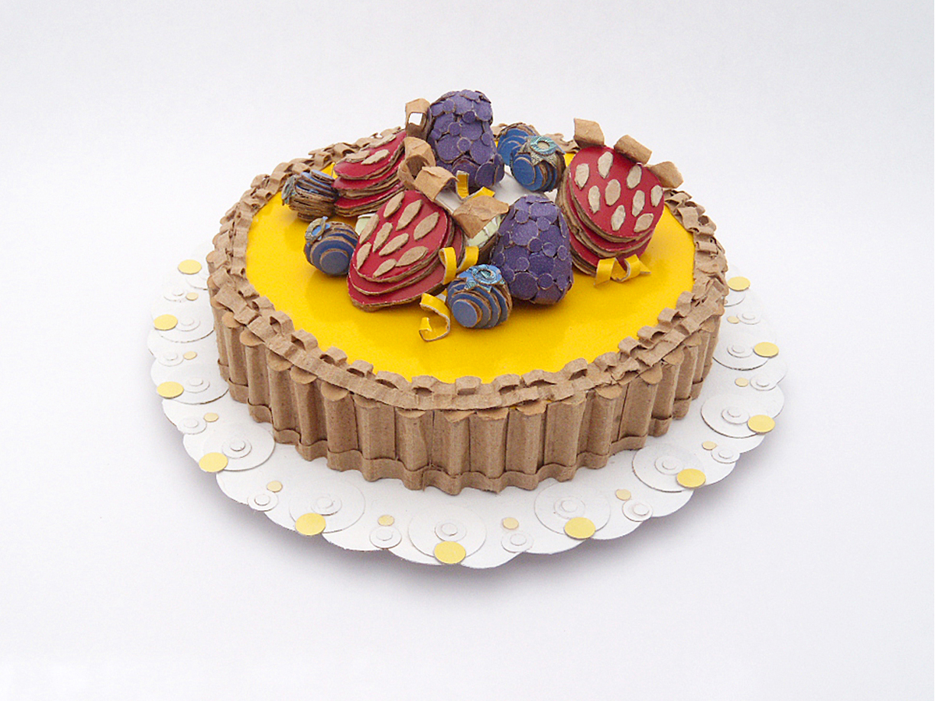
Sweet Treats Sculpture Challenge
For the next week we are going to be working on a cardboard sculpture challenge inspired by the amazing work of artist Patianne Stevenson.
Take a look at her website here:
Found Cardboard Sculpture – Patianne Stevenson Art
Your challenge is to create a 3-D sculpture inspired by the theme of “Sweet Treats”.
You can choose which sweet treat you would like to make.
Your sculpture should be to scale - it should be true to size.
Your sculpture should be made from recycled materials.

Slide 3
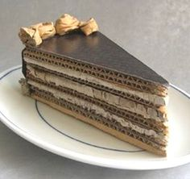
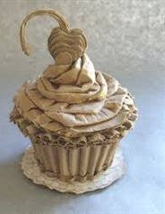
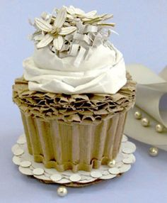
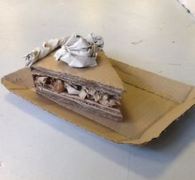
You will need the following materials:
Cardboard
You can use any type or cardboard you can find in your house. Corrugated cardboard is brilliant but you can also use a carboard box or cereal boxes.
Newspaper and/ or scrap paper
Sellotape, masking tape or glue
Scissors
If you don’t have access to these materials you can be creative about what you use, what other materials do you have available to you that you could use to create your 3-D sculpture?

Slide 4
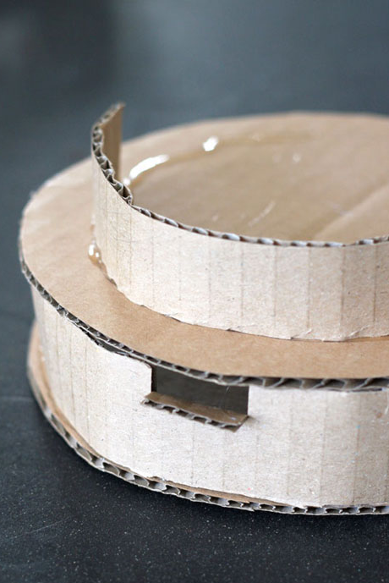
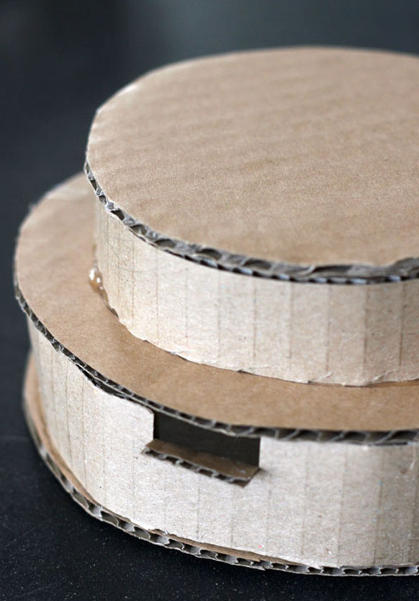
1.
Some tips:
Find a reference image of your chosen cake or treat to refer back to while you are creating your sculpture
Start with the basic shape of the base of your cake.
Are you creating a round cupcake? A wedge-shaped slice? A rectangular cake?
Draw and cut out the base of your cake first and build up from there.
You can build the 3-D form of your cake by cutting layers and sticking them one on top of each other (Picture 1)
Or
You can build the 3-D form of your cake by cutting strips for the sides and sticking these around your base (Picture 2 & 3)
2.
3.

Slide 5
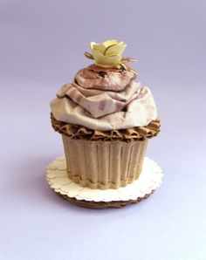

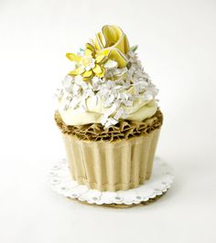
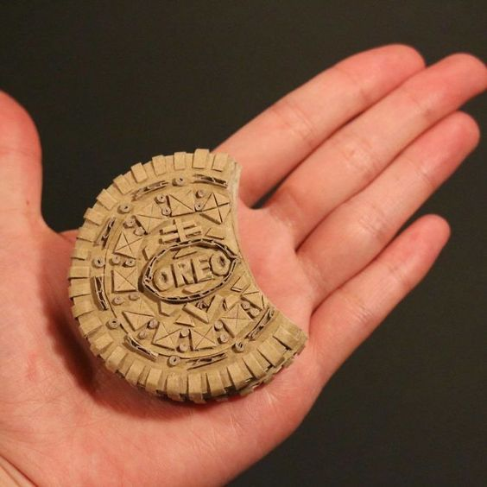
Once you have created the basic 3-D form of your cake or sweet treat you can start to add detail.
Think about using scrunched paper to create the effect of icing or whipped cream.
Think about the different textures of cardboard you have – could you use the corrugated side to create texture?
Think about how you can cut and bend your paper or cardboard to create different forms – you could create chocolate shavings, sprinkles, fruit and other decorations.
Be creative – the more detail you can add the more effective your sculpture will be!

