Slide 1

Write your title here
Don’t forget the author’s name!

Slide 2
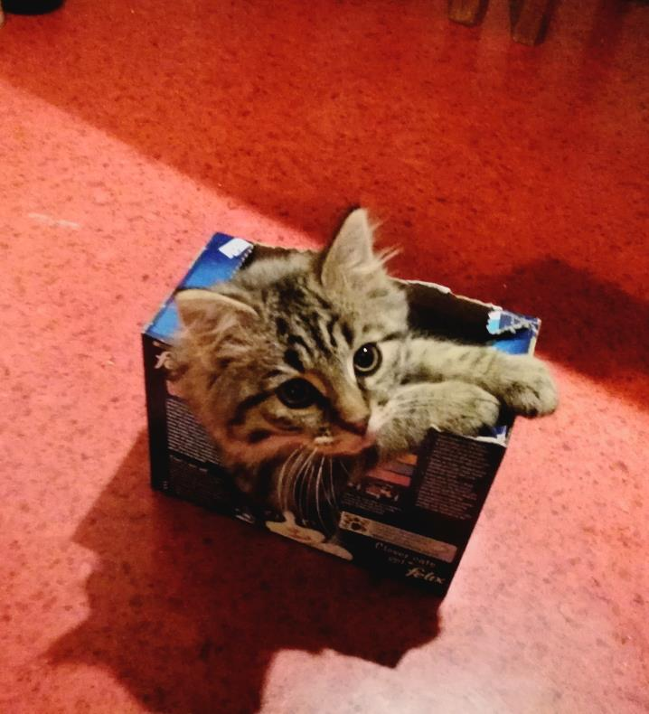
You are going to turn your story into a book.
The first thing you will need to decide is how much text to include on each page.

Slide 3
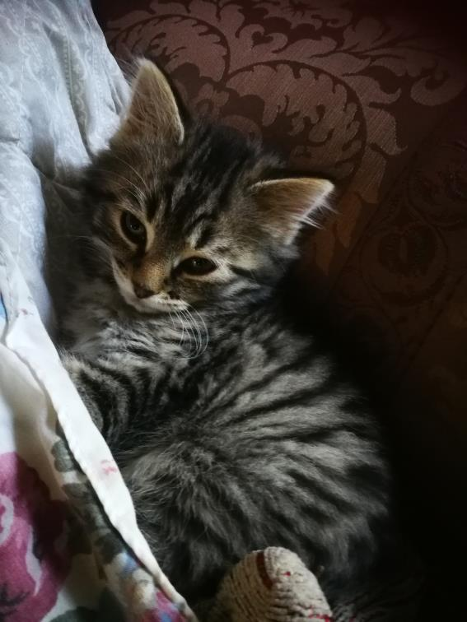
You could make your text very large
Or much smaller, but keep it consistent throughout your book.

Slide 4
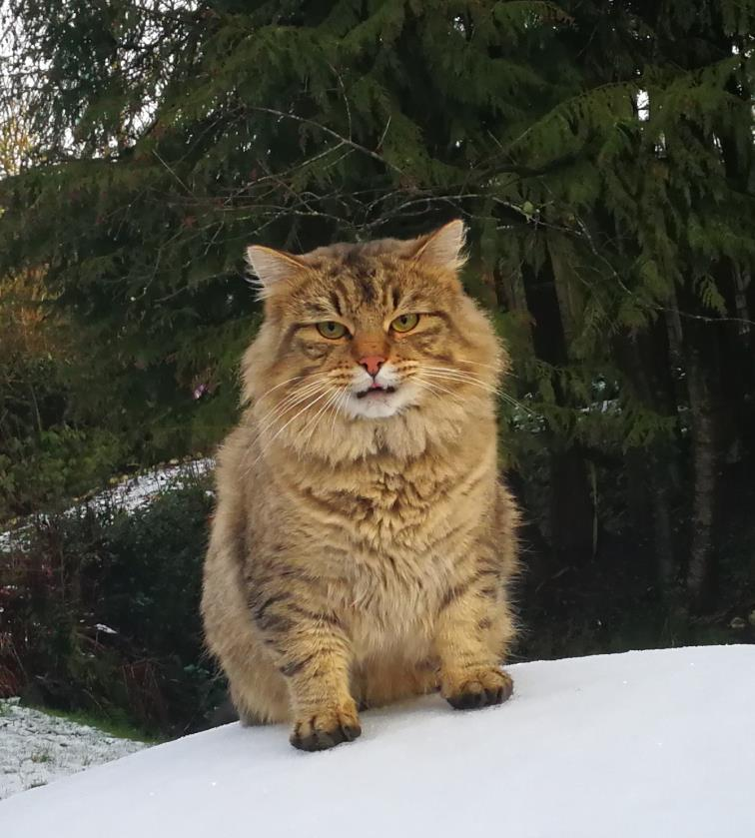
Think about illustrations. You could draw some of your own or take some photos to include.
All of these cat photos are from Miss Ickeringill. She has a cat called Boris and last year P7 wrote a story about their own pets, during lockdown.
If you don’t want to draw or take pictures you could download some images from online content.
Or you could delete all the photos and just have text on each page.

Slide 5
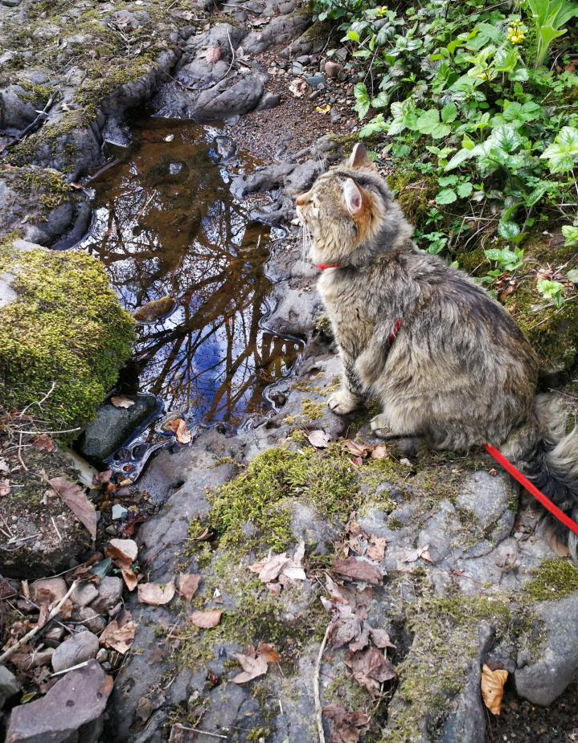
Think about how you will space out your story.
How long do you want you book to be?
You can delete or add pages too.

Slide 6
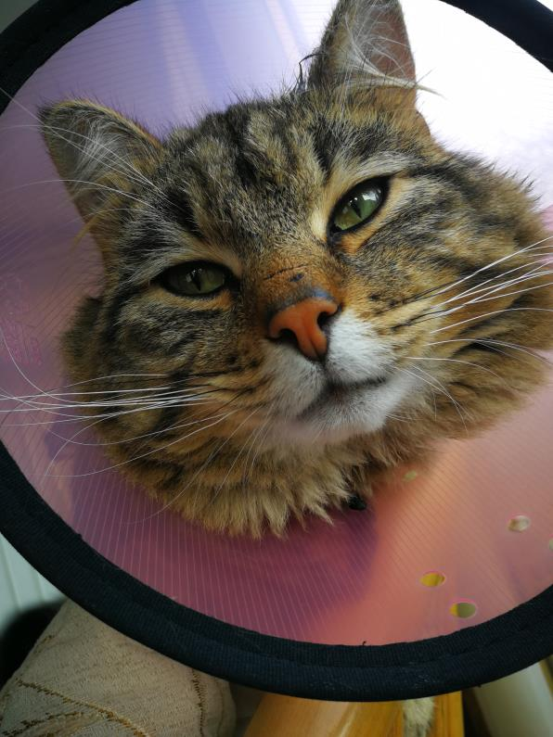
Another thing you might like to do is to add some animations – this will make your book a little interactive. You don’t have to do this, you might like the simple page turning format like a printed book

Slide 7
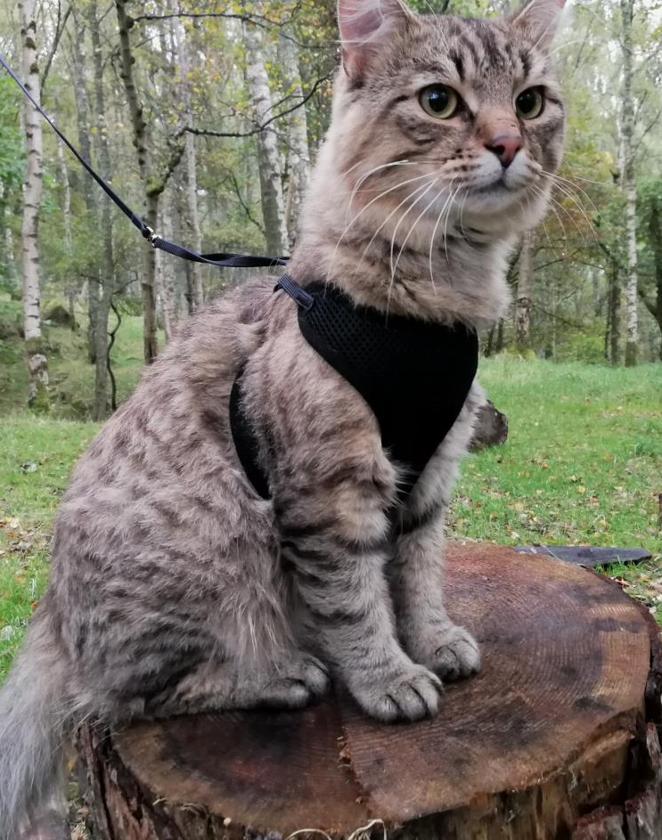
Practise playing your book using the tabs above. Think about how it looks.
If you need to make changes or shift parts of the story around it is easy to cut, copy and paste – use the right click.

Slide 8
This space is for your blurb.
Remember a blurb has 3 elements
A bit to entice the reader
An exciting quote from the book
Endorsements from readers (we’ll do this after we share with each other)

